Slide 1

How to speak developer 101
Notes:
Welcome to todays talk on How to speak developer 101
This is the first talk for the year, we’ll be covering some generals concepts and buzz words that you might have heard at some point
We will be doing a series of 101 talks for the rest of the year covering topics like Business Analysis 101 UX 101
You don’t need any prior knowledge to join these talks
Looking forward to seeing you all throughout the year

Slide 2
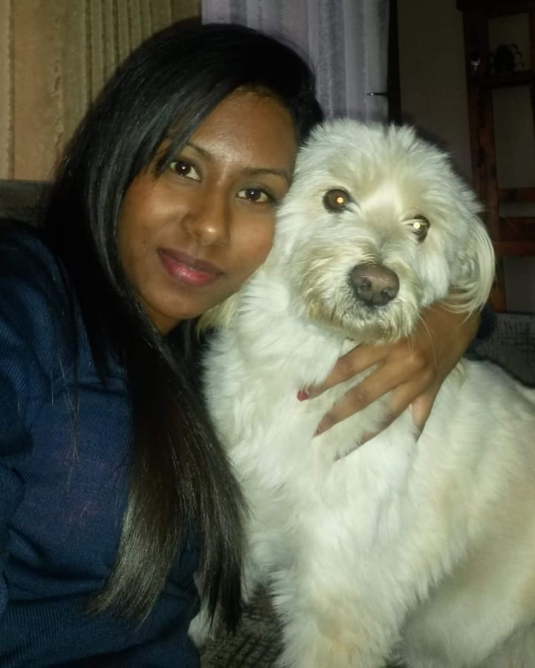
WELCOME
I AM PATRICIA (PATTY) REDDY
I am a Senior Software Engineer at Entelect. I love coding, doggies and assisting animal shelters with their needs.
You can find me at : patricia.reddy@entelect.co.za

Slide 3

Content
What Is Software Development
What Is A Coding Language
Software Development Life Cycle (SDLC)
Methodologies
Members In Agile Team
Three-Tier Application
Application Programming Interfaces (APIs)
Developer Terminology
Basic Building Blocks
Notes:
If you have any questions on topics not covered in this presentation, please feel free to raise your hand or drop a message in the chat

Slide 4
What Is Software Development?
Notes:
If someone walks up to you on the street and offers you 1mill , if you can tell them what software development is, what would you say?

Slide 5
What Is Software Development?
Software – set of instructions or programs
Software development – computer science activities dedicated to creating, designing & supporting software
Software developer – implements software development through a coding language & employs testing & maintenance of software
Notes:
Software itself is the set of instructions or programs that tell a computer what to do.
Software development refers to a set of computer science activities dedicated to the process of creating, designing, deploying and supporting software
A software developer carries out software development through a coding language to meet an objective and will control the testing and maintenance of the software product.
Now that you know what software development is, you can answer the question and win some good money ☺

Slide 6
What Is A Coding Language?
Notes:
Does anyone know of examples of coding languages?

Slide 7
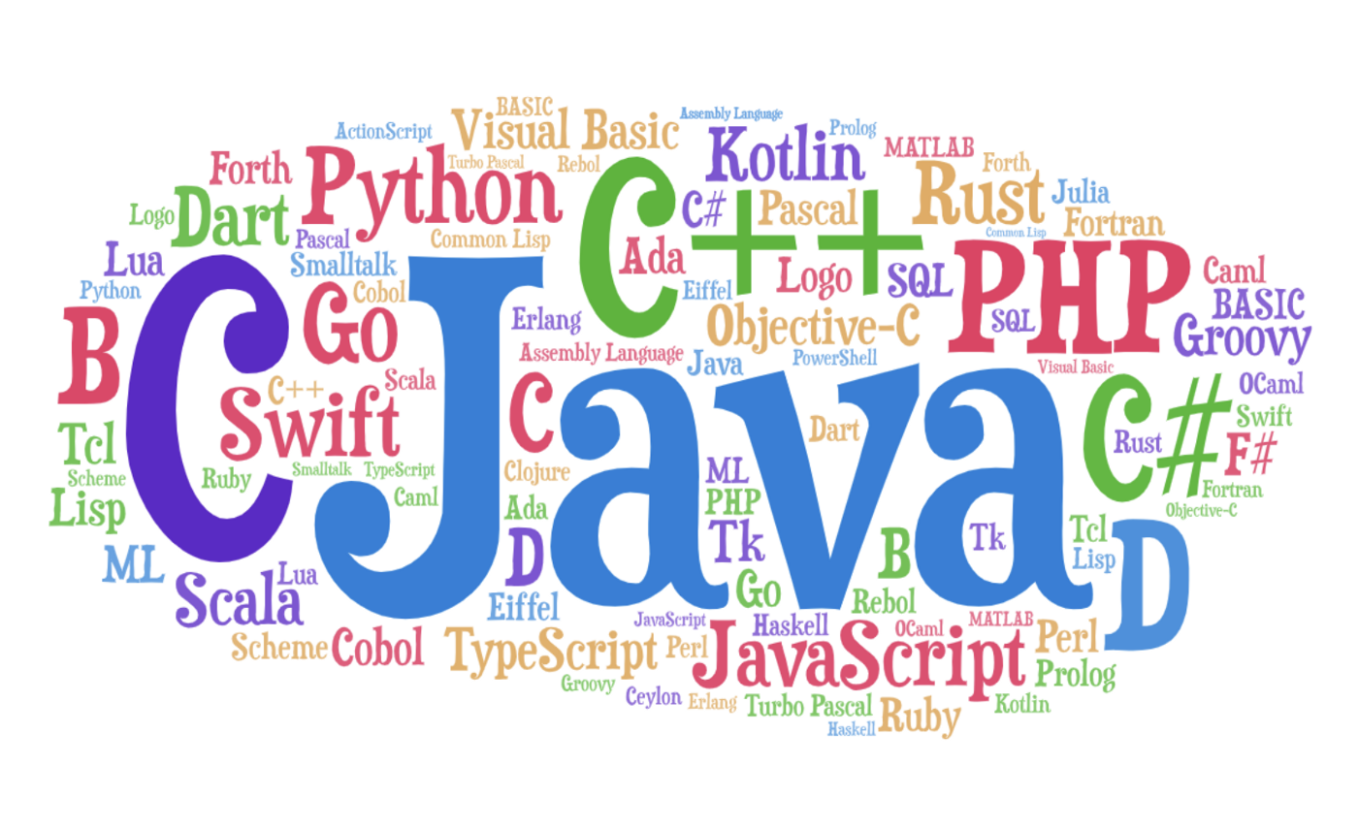
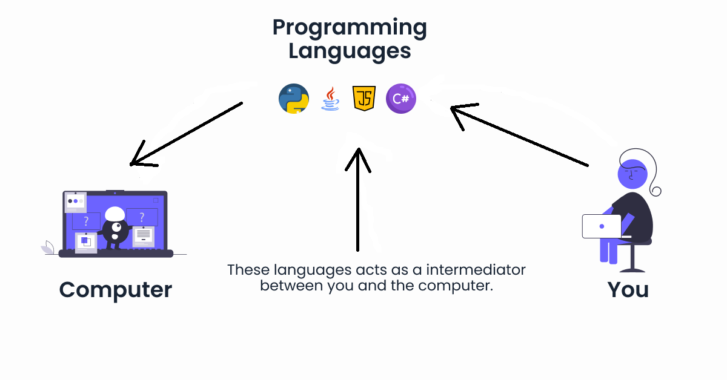
What Is A Coding Language?
Notes:
A coding language is what humans use to instruct the computer to do something
Like we have different languages in different areas of the world, we can think of computers as having their own language.
Like English has 26 letters of the alphabet, with which we use to make up all our words for effective communication; the computer has an understands binary 1’s and 0’s to make up its language of effective communication.
We do not understand 1’s and 0’s and the computer does not understand our languages…so we use code in abstraction of a language to translate between the human and the machine.

Slide 8

What Is A Coding Language?
Notes:
A coding language is what humans use to instruct the computer to do something
Like we have different languages in different areas of the world, we can think of computers as having their own language.
Like English has 26 letters of the alphabet, with which we use to make up all our words for effective communication; the computer has an understands binary 1’s and 0’s to make up its language of effective communication.
We do not understand 1’s and 0’s and the computer does not understand our languages…so we use code in abstraction of a language to translate between the human and the machine.

Slide 9
What Is A Coding Language?
Hello World Example
English - Show user a message of “Hello World!”
Compiler (translates source code from a high-level language to lower level)
01001000 01100101 01101100 01101100 01101111 00100000 01010111 01101111 01110010 01101100 01100100 00100001
C# - Console.WriteLine(“Hello World”)
Python - print(“Hello World!”)
Notes:
Hello World – Devs always use this when learning a new concnept/language
A coding language is what humans use to instruct the computer to do something
Like we have different languages in different areas of the world, we can think of computers as having their own language.
Like English has 26 letters of the alphabet, with which we use to make up all our words for effective communication; the computer has an understands binary 1’s and 0’s to make up its language of effective communication.
We do not understand 1’s and 0’s and the computer does not understand our languages…so we use code in abstraction of a language to translate between the human and the machine.

Slide 10
Software Development Life Cycle (SDLC)
Notes:
Does anyone know what the SDLC is?

Slide 11
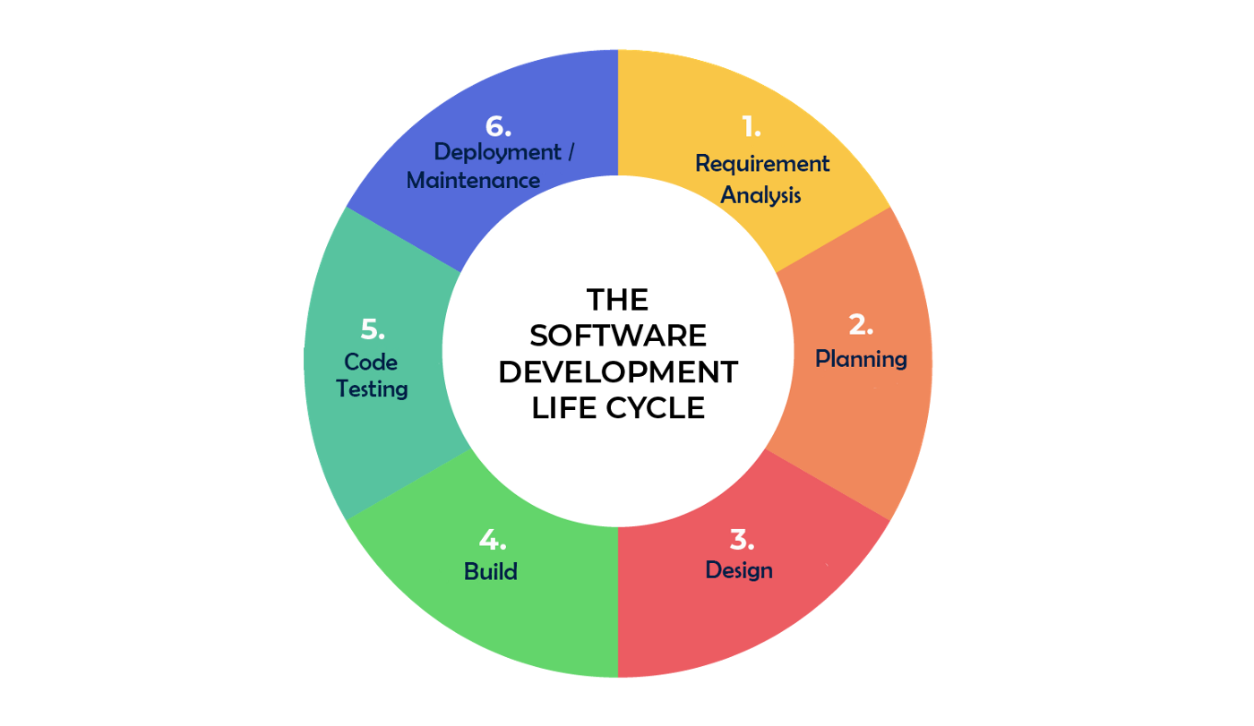
SDLC
Requirement Analysis
Document business & functional requirements
Requirements analysis is typically done by the Business Analyst
Notes:
Requirements gathering: Understand the business domain and business rules.
Analysis: Elicit and document business and functional requirements that satisfy the business rules.
Planning: Do we have enough funding / resources to work on the project to meet the schedule, What is the scope of the system, the objectives of the new system
Helps identify issues that may effect development
Design: Screens, user journey, and technical architecture.
Development: Implement the functional requirements and screen designs using coding languages.
Testing:
By developers to ensure that the code behaves as the developer intended it to.
By testers to ensure that the system behaves as intended and that the business rules are satisfied.
Implementation: Ensure that the software is distributed to users. This may be through a physical medium (such as CDs), or an online distribution platform. One example of an online distribution platform is the App store you access using your cellphone.
Maintenance: Ongoing support and bug-fixes. (Note that a “bug” is an error, flaw or fault in software that causes it to produce an incorrect or unexpected result, or to behave in unintended ways)

Slide 12
SDLC
Planning
Project Schedule
Funding & resources
Scope & objectives of the system
Notes:
Requirements gathering: Understand the business domain and business rules.
Analysis: Elicit and document business and functional requirements that satisfy the business rules.
Planning: Do we have enough funding / resources to work on the project to meet the schedule, What is the scope of the system, the objectives of the new system
Helps identify issues that may effect development
Design: Screens, user journey, and technical architecture.
Development: Implement the functional requirements and screen designs using coding languages.
Testing:
By developers to ensure that the code behaves as the developer intended it to.
By testers to ensure that the system behaves as intended and that the business rules are satisfied.
Implementation: Ensure that the software is distributed to users. This may be through a physical medium (such as CDs), or an online distribution platform. One example of an online distribution platform is the App store you access using your cellphone.
Maintenance: Ongoing support and bug-fixes. (Note that a “bug” is an error, flaw or fault in software that causes it to produce an incorrect or unexpected result, or to behave in unintended ways)

Slide 13
SDLC
Design
Screens, user journey, technical architecture
A UX specialist is responsible for the design of screens and journey
Developers & Architects are responsible for designing the technical architecture of the software
Notes:
Requirements gathering: Understand the business domain and business rules.
Analysis: Elicit and document business and functional requirements that satisfy the business rules.
Planning: Do we have enough funding / resources to work on the project to meet the schedule, What is the scope of the system, the objectives of the new system
Helps identify issues that may effect development
Design: Screens, user journey, and technical architecture.
Development: Implement the functional requirements and screen designs using coding languages.
Testing:
By developers to ensure that the code behaves as the developer intended it to.
By testers to ensure that the system behaves as intended and that the business rules are satisfied.
Implementation: Ensure that the software is distributed to users. This may be through a physical medium (such as CDs), or an online distribution platform. One example of an online distribution platform is the App store you access using your cellphone.
Maintenance: Ongoing support and bug-fixes. (Note that a “bug” is an error, flaw or fault in software that causes it to produce an incorrect or unexpected result, or to behave in unintended ways)

Slide 14
SDLC
Build
Implement requirements & designs using a coding language
Developers are responsible for implementing these requirement and building the software
Notes:
Requirements gathering: Understand the business domain and business rules.
Analysis: Elicit and document business and functional requirements that satisfy the business rules.
Planning: Do we have enough funding / resources to work on the project to meet the schedule, What is the scope of the system, the objectives of the new system
Helps identify issues that may effect development
Design: Screens, user journey, and technical architecture.
Development: Implement the functional requirements and screen designs using coding languages.
Testing:
By developers to ensure that the code behaves as the developer intended it to.
By testers to ensure that the system behaves as intended and that the business rules are satisfied.
Implementation: Ensure that the software is distributed to users. This may be through a physical medium (such as CDs), or an online distribution platform. One example of an online distribution platform is the App store you access using your cellphone.
Maintenance: Ongoing support and bug-fixes. (Note that a “bug” is an error, flaw or fault in software that causes it to produce an incorrect or unexpected result, or to behave in unintended ways)

Slide 15
SDLC
Code Testing
Ensures the system meets the requirements & works as intended
Code testing is typically done by the software testers
Notes:
Requirements gathering: Understand the business domain and business rules.
Analysis: Elicit and document business and functional requirements that satisfy the business rules.
Planning: Do we have enough funding / resources to work on the project to meet the schedule, What is the scope of the system, the objectives of the new system
Helps identify issues that may effect development
Design: Screens, user journey, and technical architecture.
Development: Implement the functional requirements and screen designs using coding languages.
Testing:
By developers to ensure that the code behaves as the developer intended it to.
By testers to ensure that the system behaves as intended and that the business rules are satisfied.
Implementation: Ensure that the software is distributed to users. This may be through a physical medium (such as CDs), or an online distribution platform. One example of an online distribution platform is the App store you access using your cellphone.
Maintenance: Ongoing support and bug-fixes. (Note that a “bug” is an error, flaw or fault in software that causes it to produce an incorrect or unexpected result, or to behave in unintended ways)

Slide 16
SDLC
Deployment/Maintenance
Make available to users, system upgrades, bug fixes etc
Also done by the developer(s) who worked on building the software initially
Notes:
Requirements gathering: Understand the business domain and business rules.
Analysis: Elicit and document business and functional requirements that satisfy the business rules.
Planning: Do we have enough funding / resources to work on the project to meet the schedule, What is the scope of the system, the objectives of the new system
Helps identify issues that may effect development
Design: Screens, user journey, and technical architecture.
Development: Implement the functional requirements and screen designs using coding languages.
Testing:
By developers to ensure that the code behaves as the developer intended it to.
By testers to ensure that the system behaves as intended and that the business rules are satisfied.
Implementation: Ensure that the software is distributed to users. This may be through a physical medium (such as CDs), or an online distribution platform. One example of an online distribution platform is the App store you access using your cellphone.
Maintenance: Ongoing support and bug-fixes. (Note that a “bug” is an error, flaw or fault in software that causes it to produce an incorrect or unexpected result, or to behave in unintended ways)

Slide 17
Methodologies
Notes:
a particular procedure or set of procedures employed by a discipline
In our case we are dealing with software development, lets have a look at 2 common methodologies

Slide 18
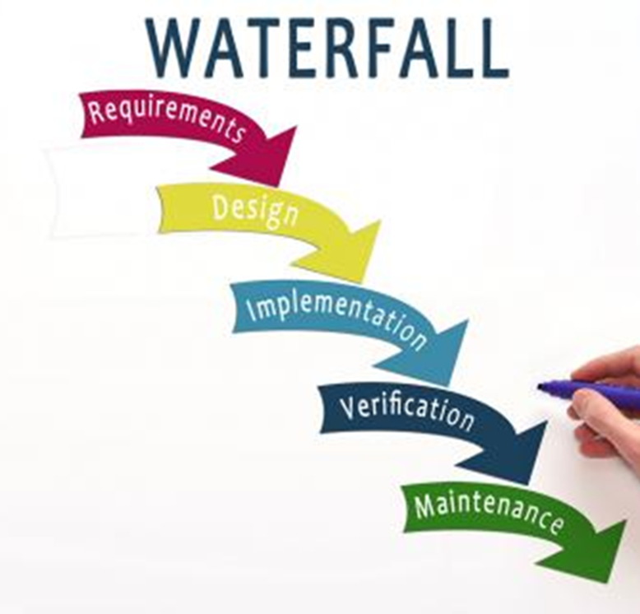
Methodologies - Waterfall
Follows sequential phases of a project
Each phase depends on deliverable from the previous phase
Entire project planning is done once, at the beginning
Difficult to make changes to the project plan

Slide 19
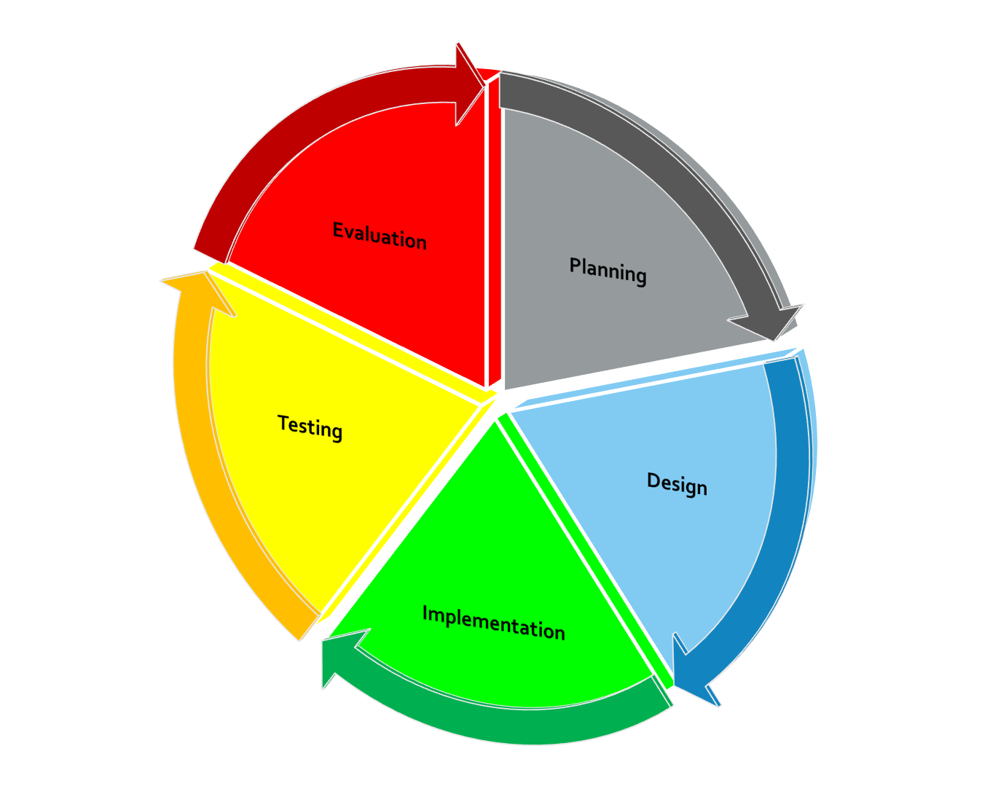
Methodologies - Agile
Requirements and solution evolves as & when the project evolves
Occurs through a collaborate effort of self-organizing & cross-functional teams
Users can quickly see the system being built
Small set of features are developed & deployed for testing
Notes:
what scenario they think waterfall is better than agile
Waterfall is best for projects where requirements are very clear and fixed.
If your project constraints are well understood and documented, Waterfall is likely the best approach

Slide 20
Members In Agile Team
Notes:
Mini activity: Does anyone want to name some of the members that they have in their team? So you know some of the members in an agile team and what their roles are?
Everyone has this idea that developers can fix computers (joke)

Slide 21

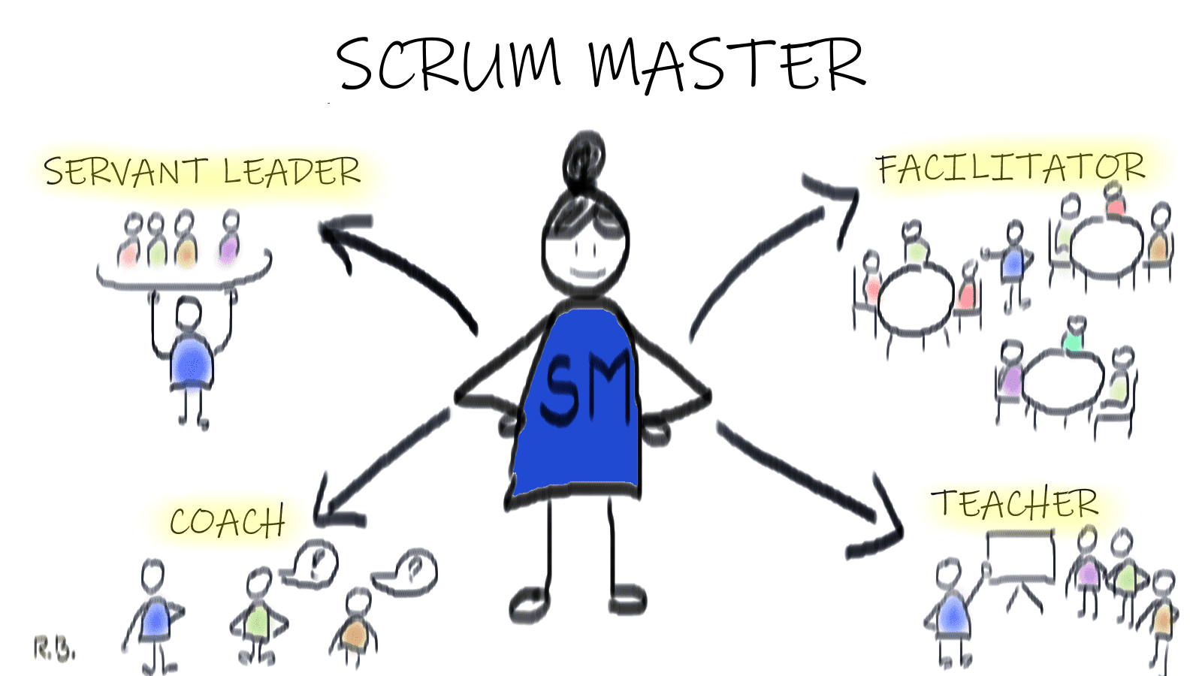
Members In Agile Team
Scrum master
Ensure team coordination and supports project progress
Notes:
Servant leader: Removing all impediments during development process
Teacher/coach: Understand the purpose of the Scrum and practicing it in an agile way on a daily basis
Facilitator: Sprint, Daily Scrum, Sprint Planning, Sprint Review and Sprint Retrospective

Slide 22
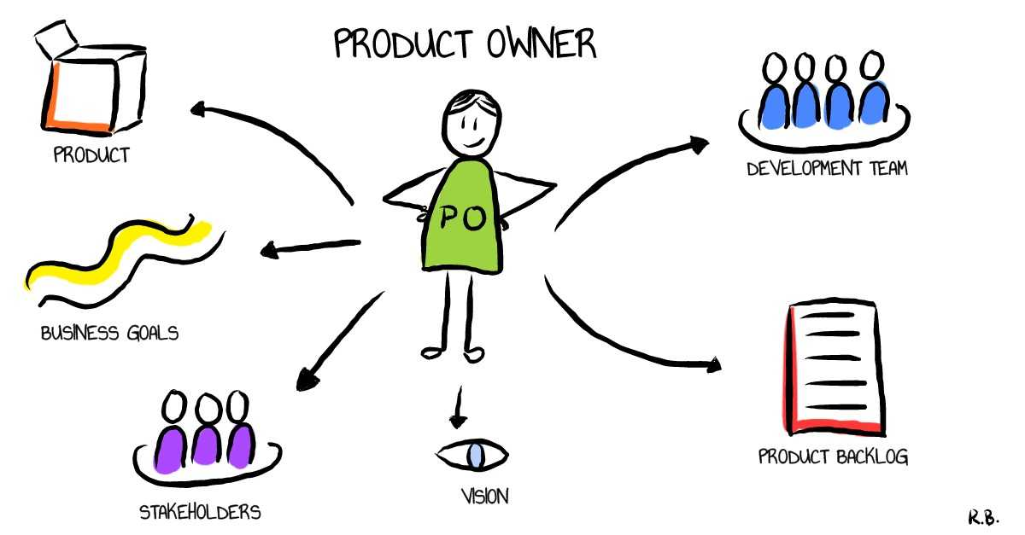
Members In Agile Team
Represent stakeholders & provide direction
Product owner

Slide 23
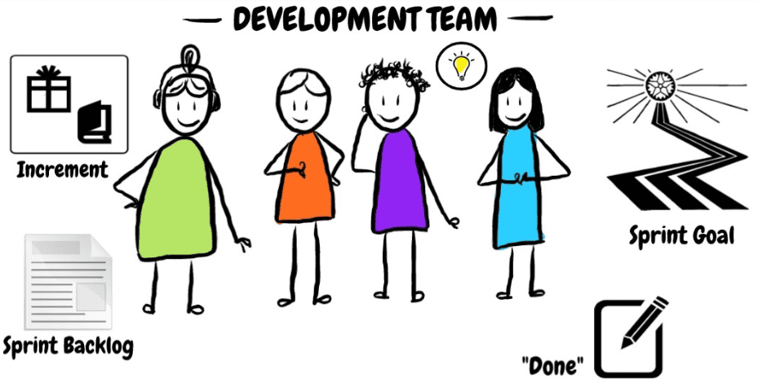
Members In Agile Team
Development Team

Slide 24
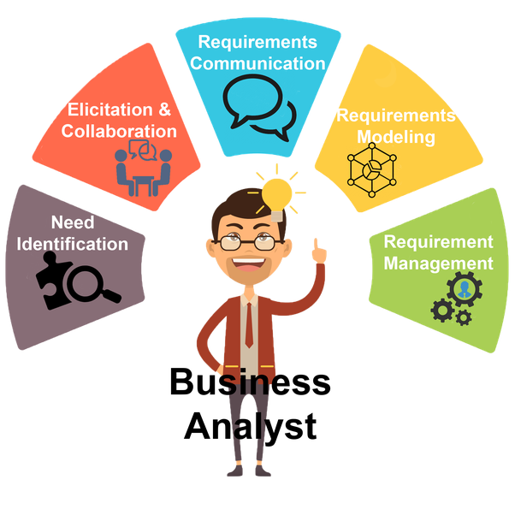
Members In Agile Team
Business Analyst
Works with stakeholders to analyze and document business processes for the system to be developed

Slide 25
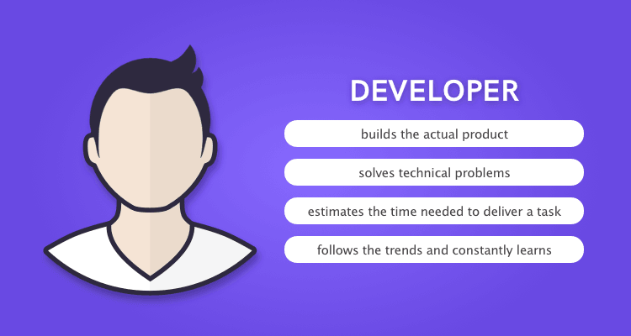
Members In Agile Team
Individuals who build the required product
Developers

Slide 26
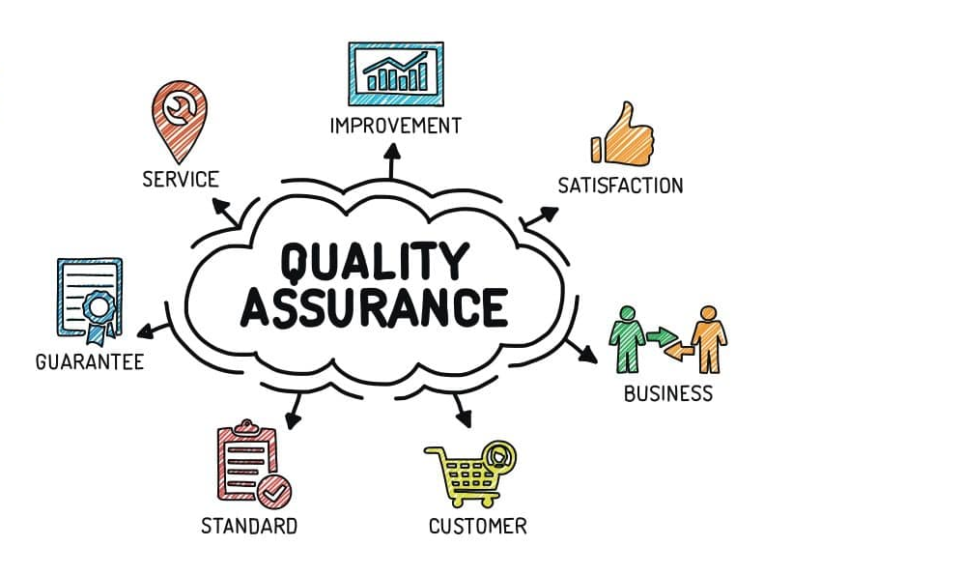
Members In Agile Team
Responsible for testing the system works as expected
Testers

Slide 27
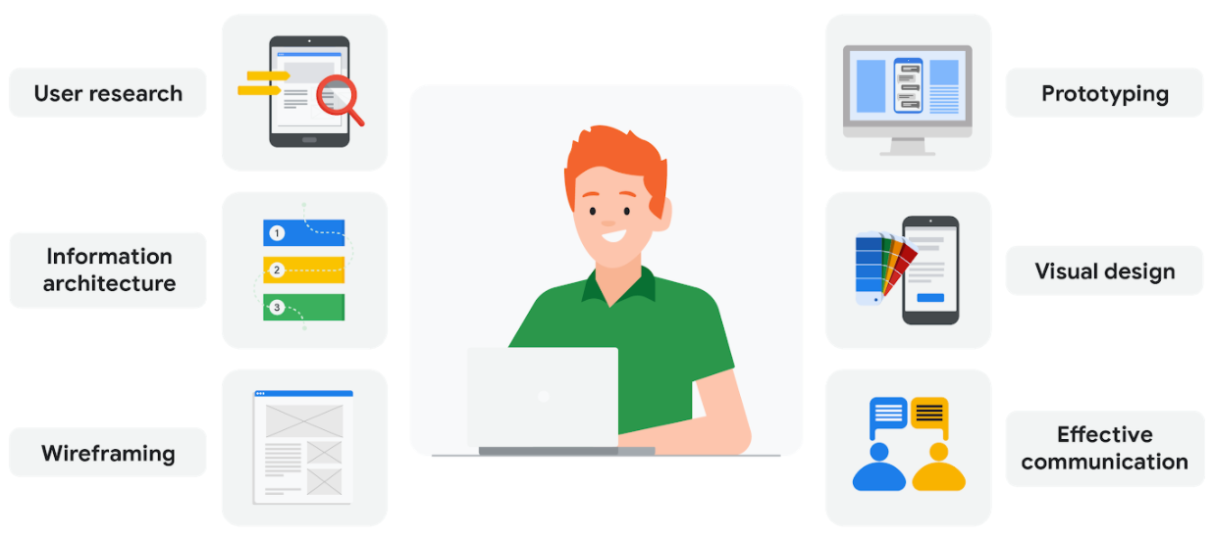
Members In Agile Team
Ensure best possible user experience
UX specialists

Slide 28
Three – Tier Application

Slide 29
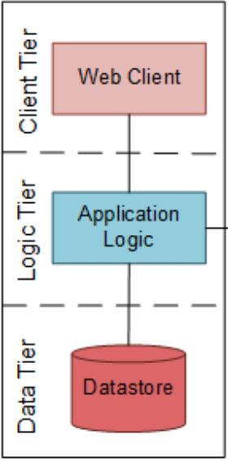
Three-Tier Application
Client/Presentation Tier
What the user sees & interacts with. Pages, buttons etc
Languages include – HTML, Javascript, Cascading Style Sheets (CSS)
Notes:
Presentation layer: It is what the user sees and interacts with. For example, the pages on a website. Languages HTML, Javascript, CSS
Application layer: Business logic that implements business rules. Languages: Java, C++, C#, Python
Data layer: Storage of data, MySql, Sql Server, Oracle Mongo
Example: Adding products to a shopping cart
User clicks on the presentation layer to add products that they want to their shopping cart
The application layer orchestrates that the products are added to the user’s cart and that the stock level of that item is reduced
The data layer stores the user’s cart so that they could come back to it later

Slide 30
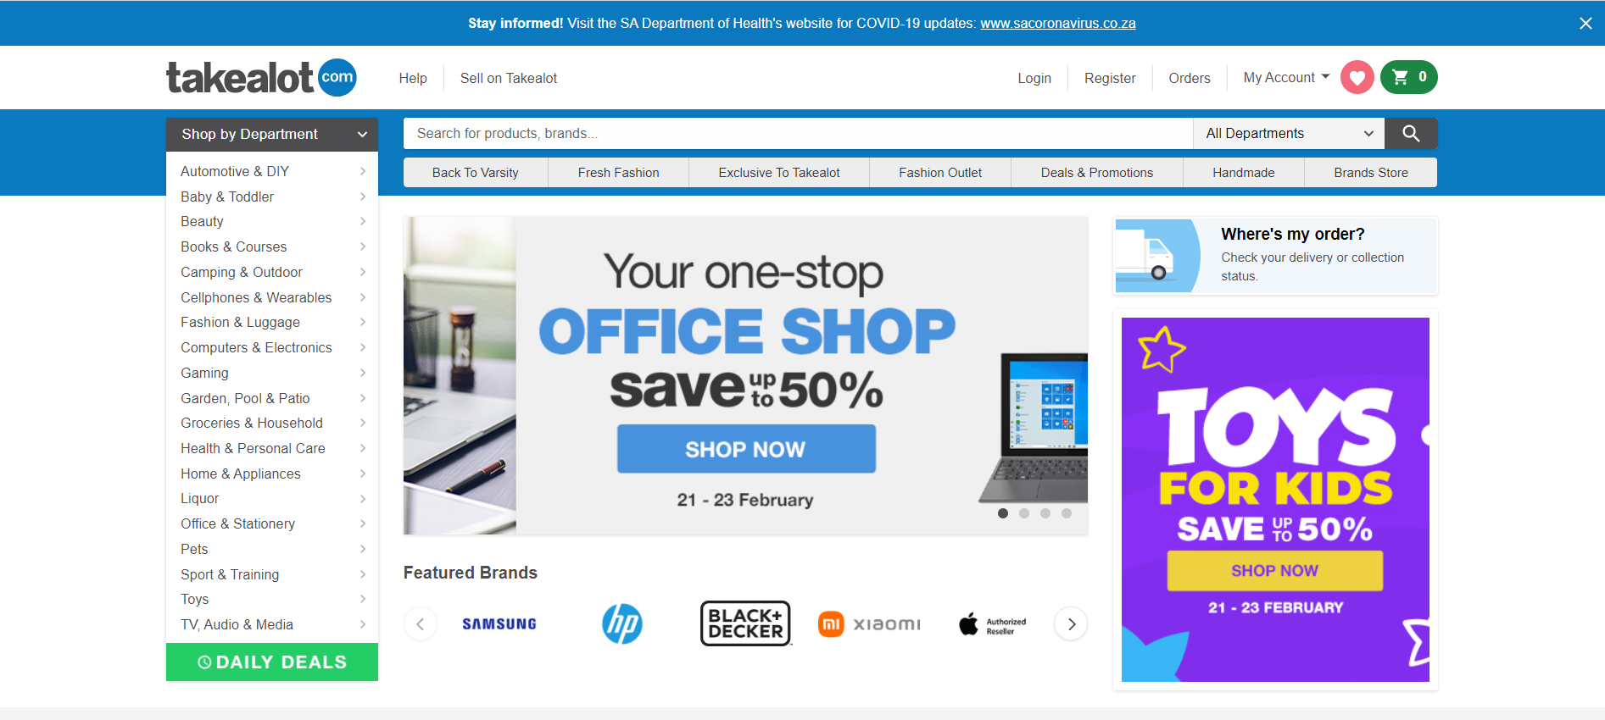
Three-Tier Application
Real World Example
Notes:
Presentation layer: It is what the user sees and interacts with. For example, the pages on a website. Languages HTML, Javascript, CSS
Application layer: Business logic that implements business rules. Languages: Java, C++, C#, Python
Data layer: Storage of data, MySql, Sql Server, Oracle Mongo
Example: Adding products to a shopping cart
User clicks on the presentation layer to add products that they want to their shopping cart
The application layer orchestrates that the products are added to the user’s cart and that the stock level of that item is reduced
The data layer stores the user’s cart so that they could come back to it later

Slide 31
Three-Tier Application
Application Logic Tier
Business logic that implement business rules
Languages include – Java, C++, C#, Python
Notes:
Presentation layer: It is what the user sees and interacts with. For example, the pages on a website. Languages HTML, Javascript, CSS
Application layer: Business logic that implements business rules. Languages: Java, C++, C#, Python
Data layer: Storage of data, MySql, Sql Server, Oracle Mongo
Example: Adding products to a shopping cart
User clicks on the presentation layer to add products that they want to their shopping cart
The application layer orchestrates that the products are added to the user’s cart and that the stock level of that item is reduced
The data layer stores the user’s cart so that they could come back to it later

Slide 32
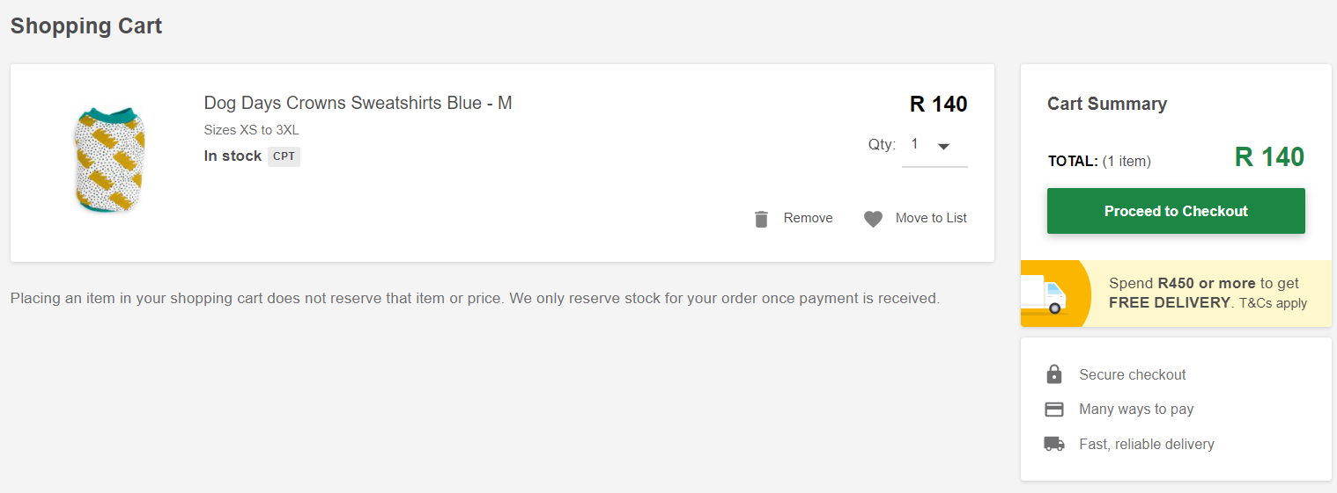
Three-Tier Application
Real World Example
Event.buttonClick(‘Proceed to Checkout’,
reserveStock()
db.update(stockOnHand – Qty.getValue())
Cart.updateItems(Qty.getValue()))
Notes:
Presentation layer: It is what the user sees and interacts with. For example, the pages on a website. Languages HTML, Javascript, CSS
Application layer: Business logic that implements business rules. Languages: Java, C++, C#, Python
Data layer: Storage of data, MySql, Sql Server, Oracle Mongo
Example: Adding products to a shopping cart
User clicks on the presentation layer to add products that they want to their shopping cart
The application layer orchestrates that the products are added to the user’s cart and that the stock level of that item is reduced
The data layer stores the user’s cart so that they could come back to it later

Slide 33
Three-Tier Application
Data Tier
Storage/Retrieval of data
Database tools include – MySQL, SQL Server, Mongo, Oracle
Notes:
Presentation layer: It is what the user sees and interacts with. For example, the pages on a website. Languages HTML, Javascript, CSS
Application layer: Business logic that implements business rules. Languages: Java, C++, C#, Python
Data layer: Storage of data, MySql, Sql Server, Oracle Mongo
Example: Adding products to a shopping cart
User clicks on the presentation layer to add products that they want to their shopping cart
The application layer orchestrates that the products are added to the user’s cart and that the stock level of that item is reduced
The data layer stores the user’s cart so that they could come back to it later

Slide 34
Three-Tier Application
Real World Example
Stock DB Qty=57
Stock Quantity Before checkout
Checkout Button
Stock Reserved
Stock DB Qty=56
Stock Quantity After checkout
Notes:
Presentation layer: It is what the user sees and interacts with. For example, the pages on a website. Languages HTML, Javascript, CSS
Application layer: Business logic that implements business rules. Languages: Java, C++, C#, Python
Data layer: Storage of data, MySql, Sql Server, Oracle Mongo
Example: Adding products to a shopping cart
User clicks on the presentation layer to add products that they want to their shopping cart
The application layer orchestrates that the products are added to the user’s cart and that the stock level of that item is reduced
The data layer stores the user’s cart so that they could come back to it later

Slide 35
Can you separate the following into the 3 layers of an application?

Slide 36
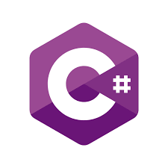

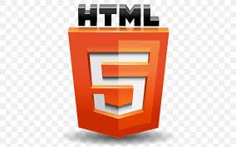





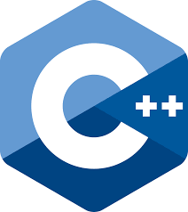

Can you separate the following into the 3 layers of an application?
Language
Database
Language for web pages
Framework
Language
Database
Language for web pages
Language
Language for styling
web pages
Language
Notes:
Presentation layer: It is what the user sees and interacts with. For example, the pages on a website. Languages HTML, Javascript, CSS
Application layer: Business logic that implements business rules. Languages: Java, C++, C#, Python
Data layer: Storage of data, MySql, Sql Server, Oracle Mongo
Example: Adding products to a shopping cart
User clicks on the presentation layer to add products that they want to their shopping cart
The application layer orchestrates that the products are added to the user’s cart and that the stock level of that item is reduced
The data layer stores the user’s cart so that they could come back to it later

Slide 37
Client Tier
Application
Tier
Data Tier

Slide 38
Application Programming Interfaces
(APIs)

Slide 39
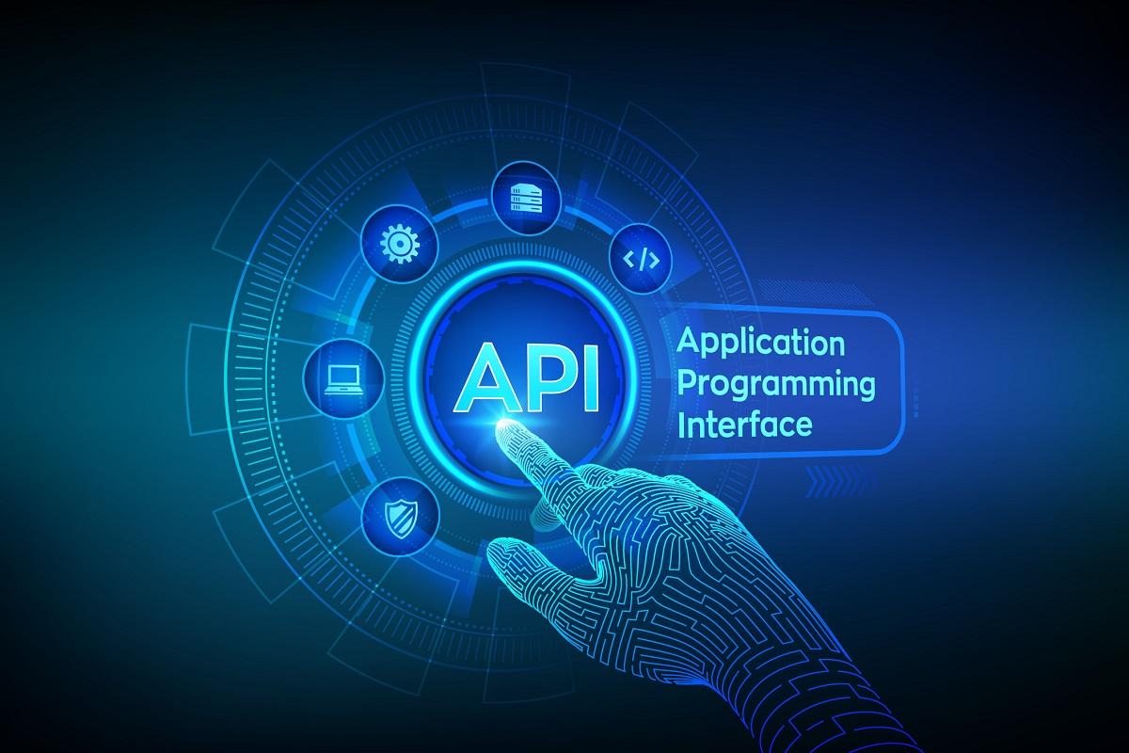
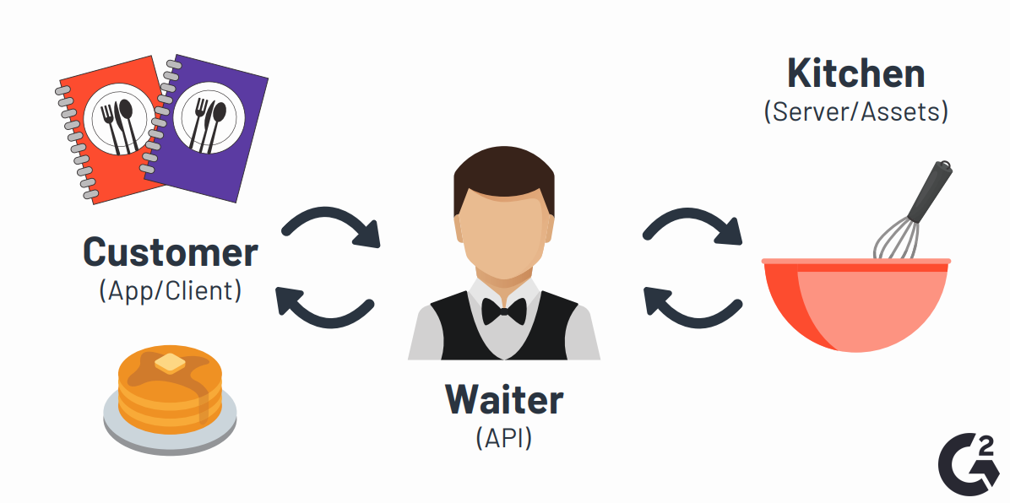
Application Programming Interfaces (APIs)
Acts as a middleman between any two machines that want to connect with each other for a specified task
Notes:
A real world example would be when you sign into Facebook from your phone you are telling the Facebook application that you would like to access your account. The mobile application makes a call to an API to retrieve your Facebook account and credentials. Facebook would then access this information from one of its servers and return the data to the mobile application.

Slide 40
APIs
Real world example
Sign into Facebook from your phone
Mobile app calls API to retrieve your account & credentials
Facebooks access information from server and returns data to the mobile app
Notes:
A real world example would be when you sign into Facebook from your phone you are telling the Facebook application that you would like to access your account. The mobile application makes a call to an API to retrieve your Facebook account and credentials. Facebook would then access this information from one of its servers and return the data to the mobile application.

Slide 41
APIs
Purpose – Separation of concerns. Application & presentation layer can change independently of each other
Benefit – Reduce code changes & the risk of unnecessary bugs
Notes:
A real world example would be when you sign into Facebook from your phone you are telling the Facebook application that you would like to access your account. The mobile application makes a call to an API to retrieve your Facebook account and credentials. Facebook would then access this information from one of its servers and return the data to the mobile application.

Slide 42
Developer Terminology
Notes:
What words have you heard of/don’t understand

Slide 43
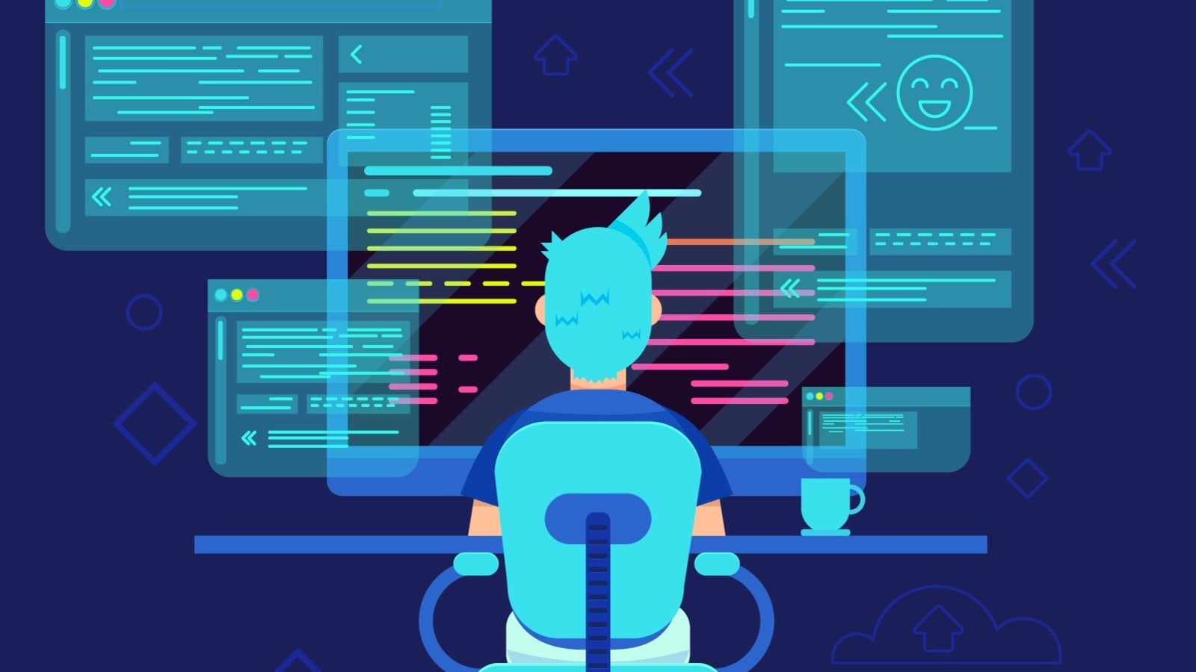
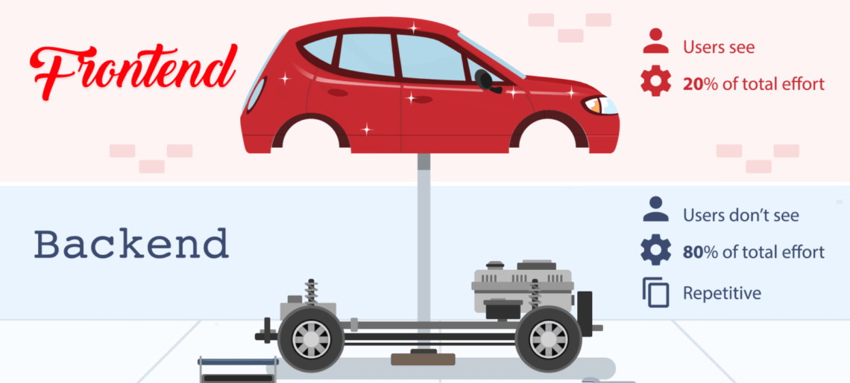
Developer Terminology
Front-end vs Back-end
Notes:
Front-end: Client/User side interface (What the user sees, touches and experiences)
Back-end: Server side interface (How everything works). Does not come into direct contact with the user but does communicate to the frontend
Full stack developer is someone who is proficient in both front-end and back-end development.
Algorithm: a process or set of rules that need to be followed in order to solve a problem
Database: organised collection of data that can be stored and accessed
Language: Is the syntax. Grammar and semantics of how you talk to/instruct your program to work (e.g. Python, C#)
Framework: Cohesive set of library code that works to simplify the programming of any given language (e.g. Angular, Bootstrap)

Slide 44
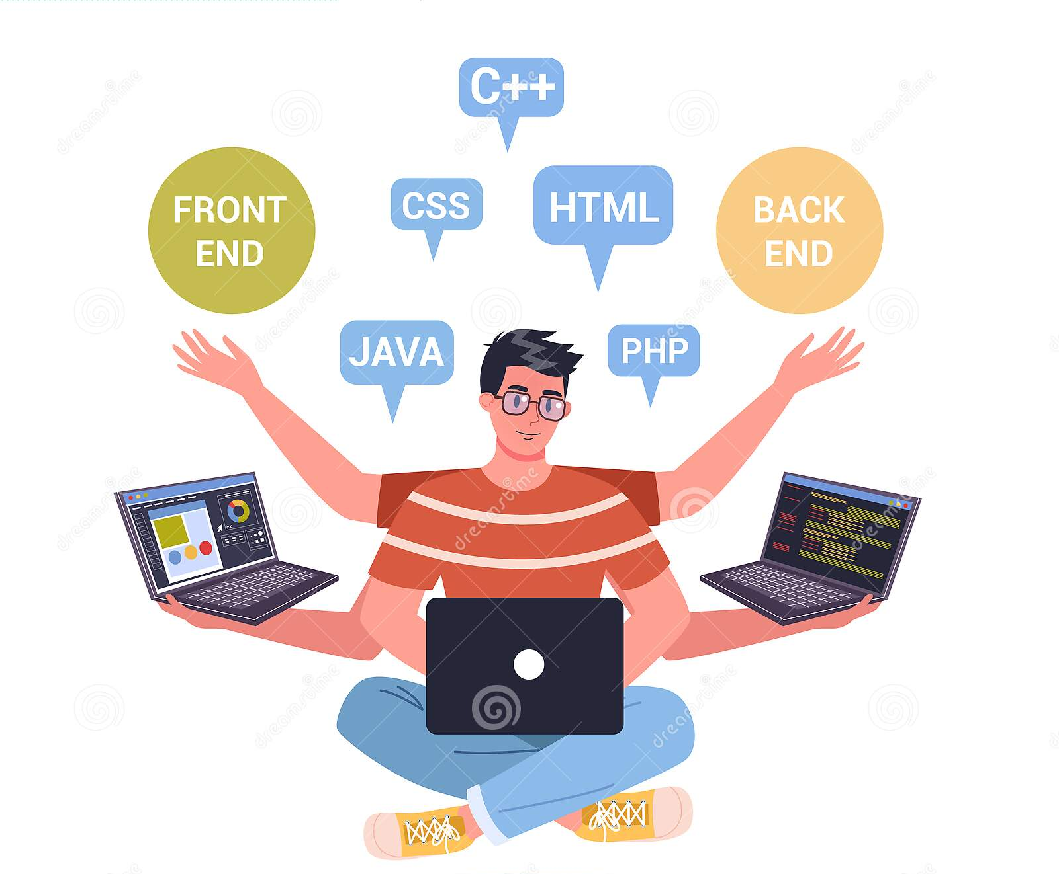
Developer Terminology
Full stack developers
Notes:
Front-end: Client/User side interface (What the user sees, touches and experiences)
Back-end: Server side interface (How everything works). Does not come into direct contact with the user but does communicate to the frontend
Full stack developer is someone who is proficient in both front-end and back-end development.
Algorithm: a process or set of rules that need to be followed in order to solve a problem
Database: organised collection of data that can be stored and accessed
Language: Is the syntax. Grammar and semantics of how you talk to/instruct your program to work (e.g. Python, C#)
Framework: Cohesive set of library code that works to simplify the programming of any given language (e.g. Angular, Bootstrap)

Slide 45
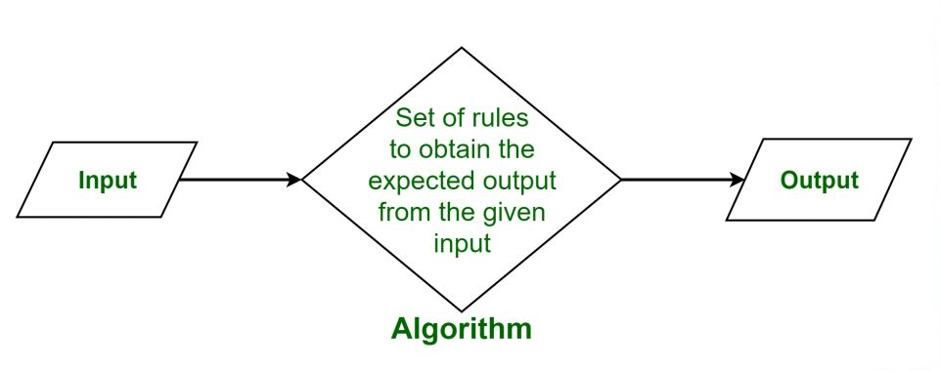
Developer Terminology
Algorithm
Notes:
Front-end: Client/User side interface (What the user sees, touches and experiences)
Back-end: Server side interface (How everything works). Does not come into direct contact with the user but does communicate to the frontend
Full stack developer is someone who is proficient in both front-end and back-end development.
Algorithm: a process or set of rules that need to be followed in order to solve a problem
Database: organised collection of data that can be stored and accessed
Language: Is the syntax. Grammar and semantics of how you talk to/instruct your program to work (e.g. Python, C#)
Framework: Cohesive set of library code that works to simplify the programming of any given language (e.g. Angular, Bootstrap)

Slide 46
Developer Terminology
Database
Notes:
Front-end: Client/User side interface (What the user sees, touches and experiences)
Back-end: Server side interface (How everything works). Does not come into direct contact with the user but does communicate to the frontend
Full stack developer is someone who is proficient in both front-end and back-end development.
Algorithm: a process or set of rules that need to be followed in order to solve a problem
Database: organised collection of data that can be stored and accessed
Language: Is the syntax. Grammar and semantics of how you talk to/instruct your program to work (e.g. Python, C#)
Framework: Cohesive set of library code that works to simplify the programming of any given language (e.g. Angular, Bootstrap)

Slide 47
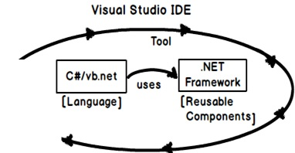
Developer Terminology
Framework vs language
Notes:
Front-end: Client/User side interface (What the user sees, touches and experiences)
Back-end: Server side interface (How everything works). Does not come into direct contact with the user but does communicate to the frontend
Full stack developer is someone who is proficient in both front-end and back-end development.
Algorithm: a process or set of rules that need to be followed in order to solve a problem
Database: organised collection of data that can be stored and accessed
Language: Is the syntax. Grammar and semantics of how you talk to/instruct your program to work (e.g. Python, C#)
Framework: Cohesive set of library code that works to simplify the programming of any given language (e.g. Angular, Bootstrap)

Slide 48
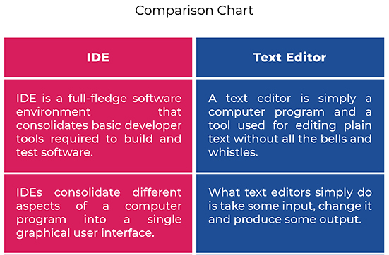
Developer Terminology
Integrated Development Environment (IDE) vs text editor
Notes:
Front-end: Client/User side interface (What the user sees, touches and experiences)
Back-end: Server side interface (How everything works). Does not come into direct contact with the user but does communicate to the frontend
Full stack developer is someone who is proficient in both front-end and back-end development.
Algorithm: a process or set of rules that need to be followed in order to solve a problem
Database: organised collection of data that can be stored and accessed
Language: Is the syntax. Grammar and semantics of how you talk to/instruct your program to work (e.g. Python, C#)
Framework: Cohesive set of library code that works to simplify the programming of any given language (e.g. Angular, Bootstrap)

Slide 49
Basic Building Blocks

Slide 50
Basic Building Blocks
Variables & Functions
Function
X =10
Result
Y = 20
Input
X
Y
30
30
Variables
Output
Number 1
Number 2
Notes:
Variable – A symbol used to define a value that is liable to change
Function – Transforms inputs into outputs

Slide 51
Basic Building Blocks
Data Type
Constrains what a variable can be (for example, characters, strings, integers, arrays, or lists, boolean, enumeration)
Character/char - stores single characters, such as 'a' or 'B‘
String - stores text, such as "Hello“ and also numbers that cannot be changed e.g ID Number
Notes:
Can you think of other String values?

Slide 52
Basic Building Blocks
Data Type
Integer – stores an integer (whole numbers), without decimals, such as 123
Decimal – stores numbers with a decimal point e.g 123.56
Boolean – stores values with two states: true or false
Notes:
The value of PI is also an example of a decimal value
Can you think of true / false examples?

Slide 53
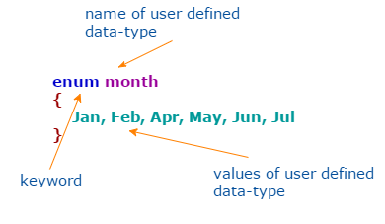
Basic Building Blocks
Enumeration/enum - used to define collections of constants
Data Type
Notes:
Can you think of other enum values?

Slide 54
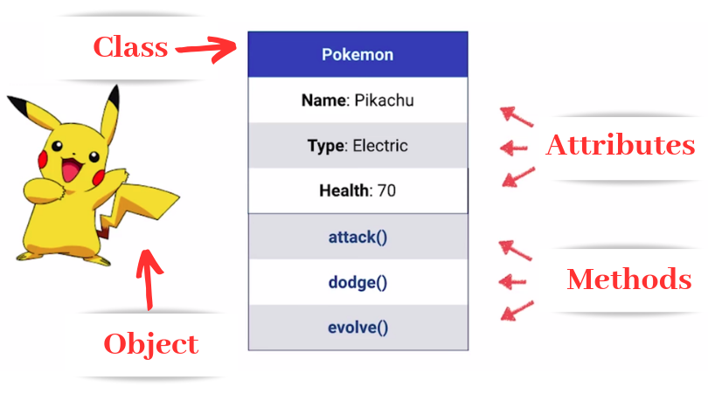
Basic Building Blocks
Classes & Objects
Notes:
Class – A blueprint for creating an object (attributes, characteristics)
Object – A virtual instance of an item created from a template (class)

Slide 55
Examples of a class and objects for online book store?
Notes:
Example of a class: Book class
Characteristics of the Book class:
Title
Author
Type (for example, eBook, paperback, hardcover)
Price (for example, in Rands)
Examples of objects for a book class:
1) Object:
Title = Pride and prejudice
Author = Jane Austen
Type = Paperback
Price = 149.00
2) Object:
Title = Fairytale
Author = Danielle Steel
Type = eBook
Price = 157.00

Slide 56

Book Class
Attribute 1 :
Attribute 2:
Attribute 3:
Attribute 4:
Notes:
Example of a class: Book class
Characteristics of the Book class:
Title
Author
Type (for example, eBook, paperback, hardcover)
Price (for example, in Rands)
Examples of objects for a book class:
1) Object:
Title = Pride and prejudice
Author = Jane Austen
Type = Paperback
Price = 149.00
2) Object:
Title = Fairytale
Author = Danielle Steel
Type = eBook
Price = 157.00

Slide 57
Book Class
Title
Genre
Author
Type Price
Notes:
Example of a class: Book class
Characteristics of the Book class:
Title
Author
Type (for example, eBook, paperback, hardcover)
Price (for example, in Rands)
Examples of objects for a book class:
1) Object:
Title = Pride and prejudice
Author = Jane Austen
Type = Paperback
Price = 149.00
2) Object:
Title = Fairytale
Author = Danielle Steel
Type = eBook
Price = 157.00

Slide 58
Title = Fairytale
Genre = Romance/Domestic fiction
Author = Danielle Steel
Type = eBook
Price = 157.00
Book Object
Book Class
Title
Genre
Author
Type Price
Book Object
Title = Pride and prejudice
Genre = Romance
Author = Jane Austen
Type = Paperback
Price = 149.00
Notes:
Example of a class: Book class
Characteristics of the Book class:
Title
Author
Type (for example, eBook, paperback, hardcover)
Price (for example, in Rands)
Examples of objects for a book class:
1) Object:
Title = Pride and prejudice
Author = Jane Austen
Type = Paperback
Price = 149.00
2) Object:
Title = Fairytale
Author = Danielle Steel
Type = eBook
Price = 157.00

Slide 59
Questions?

